Slide 1
Basics of python
Basics

Slide 2
Agenda
Basics
Datatypes
Variables, keywords, identifiers
Python I/O
Import
Operations
Basics
Presented By : Nitish Vig

Slide 3
Basics
Basics
Presented By : Nitish Vig

Slide 4
Basics
The compiler converts the python program into another code called Byte Code.
Byte Code represents a fixed set off instructions that represents all operations like Arithmetic, Comparison, Memory-related etc. which runs on any operating system and hardware.
Any computer can execute only binary code which comprises 1’s / 0’s. To convert byte code to machine code, we use Python Virtual Machine (PVM).
An interpreter translates the program source code line by line. JIT (Just In Time) compiler improve speed or execution of compiler program.
Basics
Presented By : Nitish Vig

Slide 5
Basics
Single(‘’), Double(“”) quotes are used for single lines.
Tripe single(‘‘‘’’’), double (“““”””) quotes are used for multiple lines display and comments.
# (pound) sign is used for single line comment.
Basics
Presented By : Nitish Vig

Slide 6
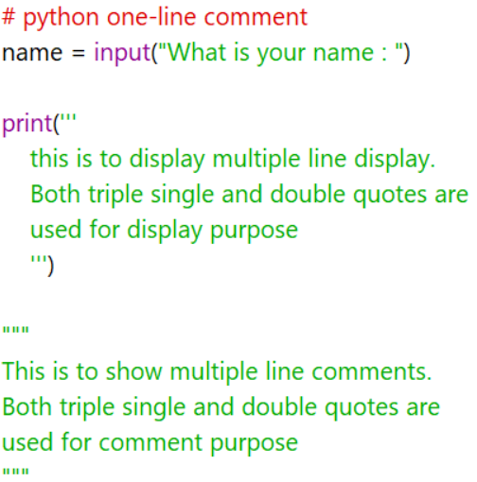
Basics
Basics
Presented By : Nitish Vig

Slide 7
Basics
Escape Characters:
\ : New line continuation
\\ : Display a single line \
\’ : Display multiple line quotes
\” : Display a single line quote
\b : Backspace
\r : Enter
\t : Horizontal Tab Space
\v : Vertical Tab Space
\n : New Line
Basics
Presented By : Nitish Vig

Slide 8
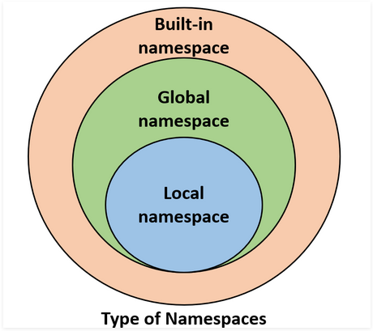
Basics
Namespaces:
A namespace is a system to make sure that all the names in a program are unique.
You might already know that everything in Python—like strings, lists, functions, etc.—is an object.
Python implements namespaces as dictionaries.
There is a name-to-object mapping, with the names as keys and the objects as values.
Basics
Presented By : Nitish Vig

Slide 9
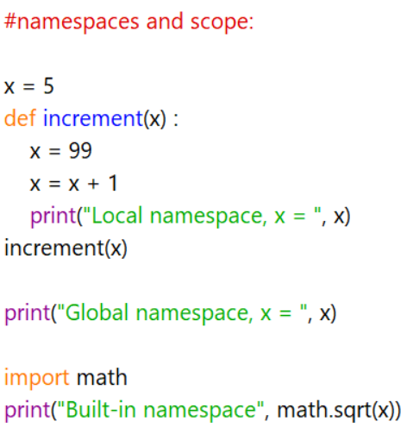
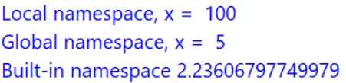
Basics
Namespaces:
Basics
Presented By : Nitish Vig

Slide 10
Keywords and identifiers
Basics
Presented By : Nitish Vig

Slide 11
Python Keywords
Keywords are the reserved words in Python.
We cannot use a keyword as a variable name, function name or any other identifier. They are used to define the syntax and structure of the Python language.
In Python, keywords are case sensitive.
Basics
Presented By : Nitish Vig

Slide 12
Python Keywords
FALSE | class | finally | is | return
None | continue | for | lambda | try
TRUE | def | from | nonlocal | while
and | del | global | not | with
as | elif | if | or | yield
assert | else | import | pass
break | except | in | raise
Basics
Presented By : Nitish Vig

Slide 13
Python Identifiers
An identifier is a name given to entities like class, functions, variables, etc. It helps to differentiate one entity from another.
Rules for writing identifiers:
1. Identifier can be of any length.
Eg: pythonFundamentalAndDataScience ; DataPython; x
2. Identifiers can be a combination of letters in lowercase (a to z) or uppercase (A to Z) or digits (0 to 9) or an underscore _.
Eg: Names like myClass, var_1 and print_this_to_screen, all are valid example.
3. An identifier cannot start with a digit.
Eg : 1variable is invalid, but variable1 is perfectly fine.
Basics
Presented By : Nitish Vig

Slide 14
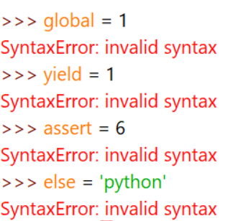
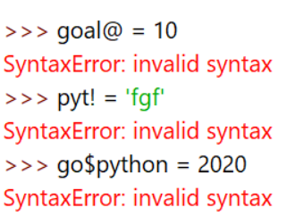
Python Identifiers
Rules for writing identifiers
4. Keywords cannot be used as identifiers.
5. We cannot use special symbols like !, @, #, $, % etc. in our identifier.
Eg:
Eg:
Basics
Presented By : Nitish Vig

Slide 15
Python
input & output
Basics
Presented By : Nitish Vig

Slide 16
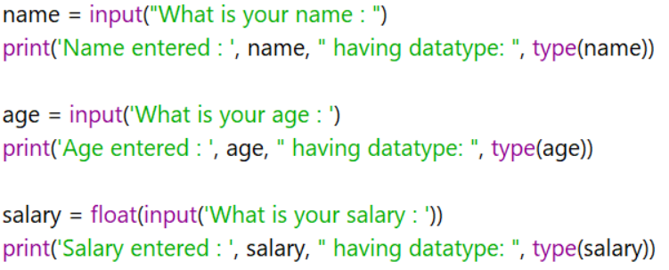
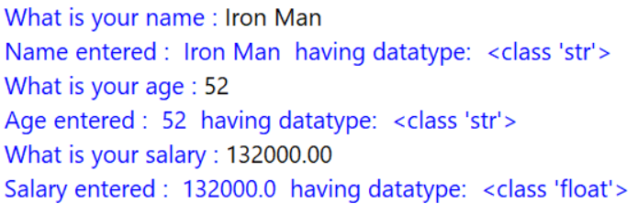
Python input and output
Keywords input is used to take input from the user. It can be any datatype.
Keywords print is used to display output to the user. It can display text message or variable
Basics
Presented By : Nitish Vig

Slide 17
Datatypes
Basics
Presented By : Nitish Vig

Slide 18
Datatypes
It represents the type of data stored in a variable / memory.
There are built-in and user-defined datatype.
Basics
Presented By : Nitish Vig

Slide 19
Built-In datatype
1. None type:
It doesn’t contain any value.
Mainly it is used in function to pass on empty values.
Eg: def sum():
In Boolean expression, it represent “False”
Basics
Presented By : Nitish Vig

Slide 20
Built-In datatype
2. Numeric:
Integer (2, 5, -6, 101)
Float (3.22, -6.11, 0.009)
Basics
Presented By : Nitish Vig

Slide 21
Built-In datatype
3. Boolean
True (1)
False (0)
A blank string “ ” is also represented as False.
Eg: abc = “ ”
Basics
Presented By : Nitish Vig

Slide 22
Built-In datatype
4. Sequences: It represents a group of elements / items.
(a) String (str)
Syntax : stringName = ‘’
Represented by a group of characters
It can be enclosed in single(‘’) or double(“”) quotes
Eg:
Name = ‘Nitish’
Gender = “Male”
abc = “I didn’t receive the gift”
xyz = ‘ Hello”s world’
Basics
Presented By : Nitish Vig

Slide 23
Built-In datatype
4. Sequences: It represents a group of elements / items.
(b) List:
Represented by a group of elements with different datatype, that can be modified directly.
Syntax : list_1 = []
Eg:
city = ['Delhi', "Mumbai", "Chennai", 'Kolkata']
fare = [2.5, 6, 6.05, 9.55]
sym = [2.55, 'Python', "datatype", 'f', 9]
dfy = [2.55, 'Python', "datatype", 'f', 9, [2.5, 6, 6.05, 9.55]]
Basics
Presented By : Nitish Vig

Slide 24
Built-In datatype
4. Sequences: It represents a group of elements / items.
(c) Tuple:
Represented by a group of elements with different datatype, that can be modified indirectly.
Syntax : tup_1 = ()
Eg:
city = ('Delhi', "Mumbai", "Chennai", 'Kolkata')
fare = (2.5, 6, 6.05, 9.55)
sym = (2.55, 'Python', "datatype", 'f', 9)
dfy = (2.55, 'Python', "datatype", 'f', 9, (2.5, 6, 6.05, 9.55))
Basics
Presented By : Nitish Vig

Slide 25





Built-In datatype
4. Sequences: It represents a group of elements / items.
(d) Range:
Represented by sequence of numbers and they are not modifiable
Syntax : range(start, end, stepsize)
Eg:
Basics
Presented By : Muna Pandey

Slide 26
Built-In datatype
4. Sequences: It represents a group of elements / items.
(e) Sets:
Represented by unordered collection of unique elements.
The elements may not appear in the same order they are written.
They can't be modified . Set items are unchangeable, but you can remove items and add new items.
Syntax : s1 = set{} s2.update([100])
print(s2)
{'f', 100, 'V', 'a'}
Eg:
s2={"a","V","f"}
print(s2)
{'f', 'V', 'a'}
Presented By : Nitish Vig

Slide 27


Built-In datatype
4. Sequences: It represents a group of elements / items.
(e) FrozenSets:
Represented by unordered collection of unique elements.
The elements may not appear in the same order they are written.
They can't be modified (eg, update, removal)
Syntax : s2 = frozenset()
Eg:
Basics
Presented By : Nitish Vig

Slide 28
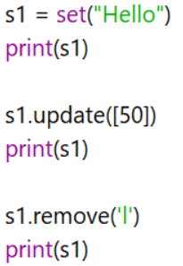
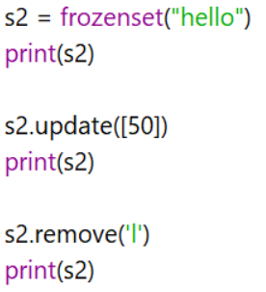
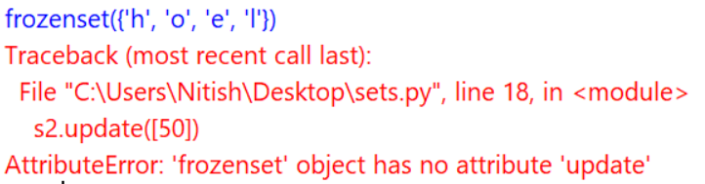
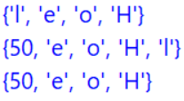
Built-In datatype
(e) Sets and FrozenSets:
Basics
Presented By : Nitish Vig

Slide 29
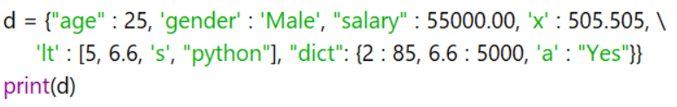
Built-In datatype
5. Dictionary(Mappings)
It represents a group values in key:value pair.
A dictionary is a collection which is ordered*, changeable and do not allow duplicates. and can be referred to by using the key name.
Syntax : dict = {}
Eg:
Basics
Presented By : Nitish Vig

Slide 30
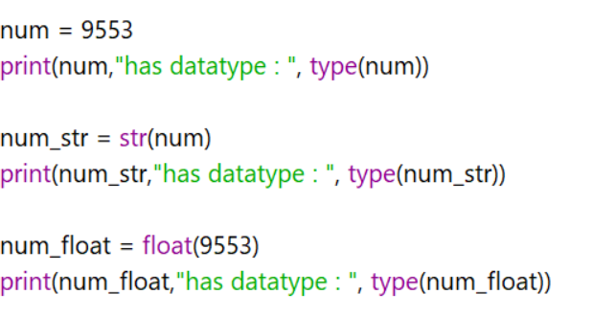
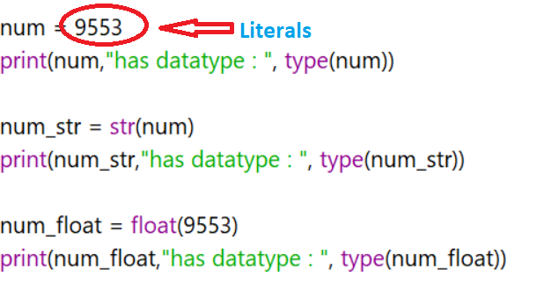
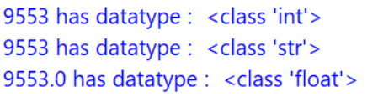
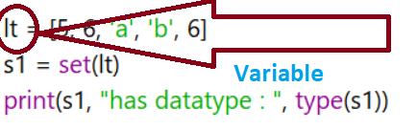
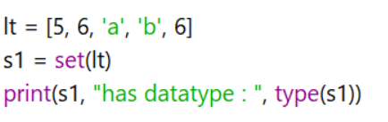
User-defined datatype (Type – Casting)
A Literal is a constant value that is stored into a variable in a program.
Basics
Presented By : Nitish Vig

Slide 31
operations
Basics
Presented By : Nitish Vig

Slide 32
Operations
Arithmetic
Assignment
Unary minus
Relational
Logical
Membership
Identity
Presented By : Nitish Vig

Slide 33
Arithmetic
Addition (+)
Subtraction (-)
Multiplication (*)
Division (/)
Remainder (%)
Exponential (**)
Integer division (//)
+=
-=
*=
/=
%=
**=
//=
Order of operation :
Exponential → Multiplication → Division → Modulus → Floor Division → Addition → Subtraction → Assignment
i = i + 1
i += 1
Basics
Presented By : Nitish Vig

Slide 34
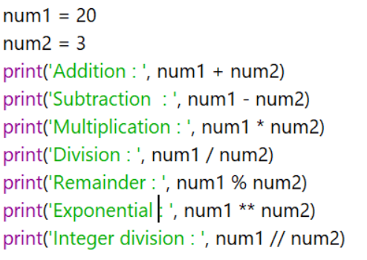
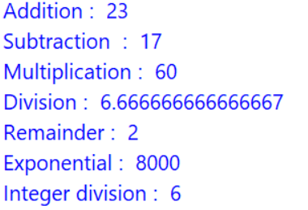
Arithmetic
Basics
Presented By : Nitish Vig

Slide 35
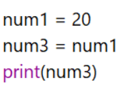
Assignment
It stores the right side literal value to the left side variable.
The arithmetic operator before assignment operator means that after operation, value is stored in the left operand.
Represented by “ = ”
Represented by “ = ”
20
Basics
Presented By : Nitish Vig

Slide 36
Unary Minus (-)
If it is used before operator, it changes the value.
Represented by “ - ”
Eg,
n = 10
print(-n) Output : -10
Eg,
n = -10
print(-n) Output : 10
Basics
Presented By : Nitish Vig

Slide 37
Relational
Sends True / False based on relation
Greater than (>)
Greater than or equal to (>=)
Less (Smaller) than (<)
Less (Smaller) than or equal to (<=)
Check if left operand equals the right (==)
Not equal (!=)
Basics
Presented By : Nitish Vig

Slide 38
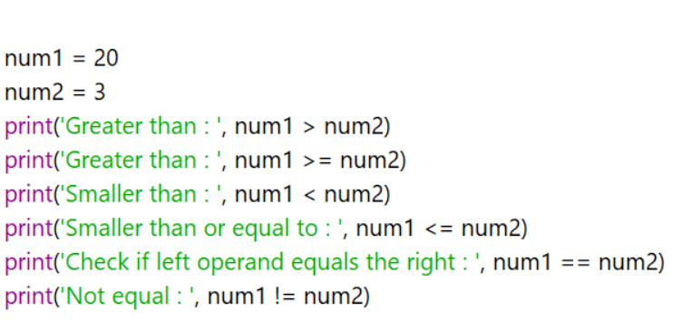
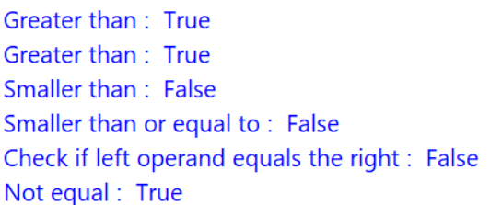
Relational
Basics
Presented By : Nitish Vig

Slide 39
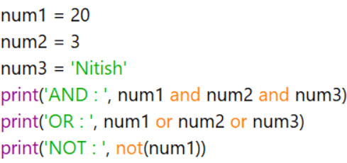
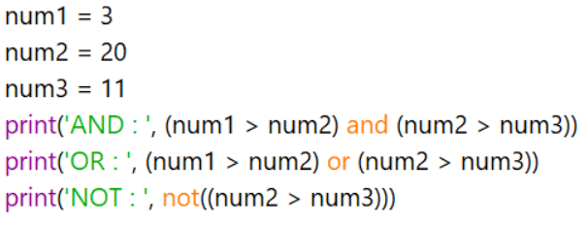
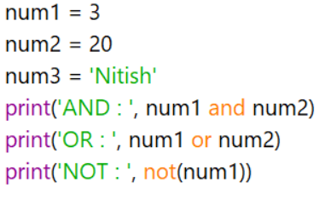
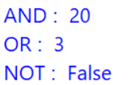
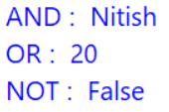
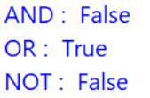
Logical
Used to make a combination of one or more simple conditions.
Represented by: AND, OR, NOT
Basics
Presented By : Nitish Vig

Slide 40
Membership Operator
This is used to check if element is present in the group.
Represented by “ in ” or “not in”
Eg,
list_1 = [10,20,30,40, “python”, “hello”]
element = 20
print(element in list_1) Output : True
Eg,
list_1 = [10,20,30,40, “python”, “hello”]
element = “hell”
print(element in list_1) Output : False
Basics
Presented By : Nitish Vig

Slide 41
Identity Operator
is and is not are the identity operators in Python. They are used to check if two values (or variables) are located on the same part of the memory. Two variables that are equal does not imply that they are identical.
(is)
x1 = 15
y1 = 15
x2 = 'Hello'
y2 = 'Hello'
x3 = [1,2,3]
y3 = [1,2,3]
# Output: False
print(x1 is not y1)
# Output: True O/P-
print(x2 is y2)
# Output: False
print(x3 is y3)
is | True if the operands are identical refer to the same object)
is not | True if the operands are not identical (do not refer to the same object)
False
True
False
Basics
Presented By : Nitish Vig

Slide 42
x1 and y1 are integers of the same values, so they are equal as well as identical. Same is the case with x2 and y2 (strings).
But x3 and y3 are lists. They are equal but not identical. It is because the interpreter locates them separately in memory although they are equal.

Slide 43
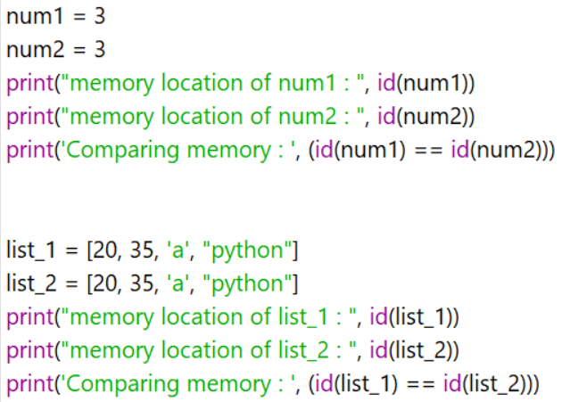
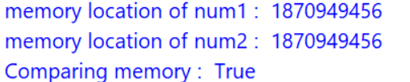
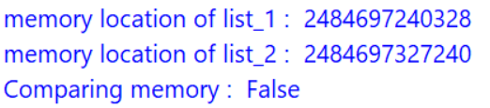
id() Function
It represents the memory location of the object.
It can be used to compare memory locations of 2 objects
Represented by “ id() ”

Slide 44
Operator Precedence / Priority Level
Parenthesis
Exponential
Unary minus, bitwise compliment
Division, multiplication, floor division
Modulus
Addition, subtraction
Bitwise left shift, Bitwise right shift
Bitwise AND
Bitwise XOR
Bitwise OR
Relational
Assignment
Identity
Membership
Logical NOT, OR, AND
[], {}, ()
**
(-), ~
/, *, //
%
+, -
<<, >>
&
^
|
<, <=, >, >=, ==, !=
=
is, is not
in, not in
Not, or, and
Basics
Presented By : Nitish Vig

